Slide 1
SLEEPING BARBER PROBLEM

Slide 2
OBJECTIVES:
Implementation of system call for sleeping barber problem
Use of system calls in project
Thread synchronization
Deadlock handling
Starvation handling

Slide 3
Project Description:
Creation of system call which prints activities of threads
Implementation of thread synchronization, deadlock handling and starvation handling using semaphores.

Slide 4
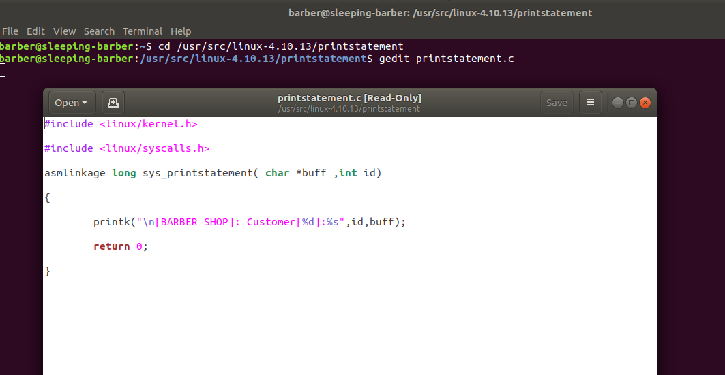

Slide 5
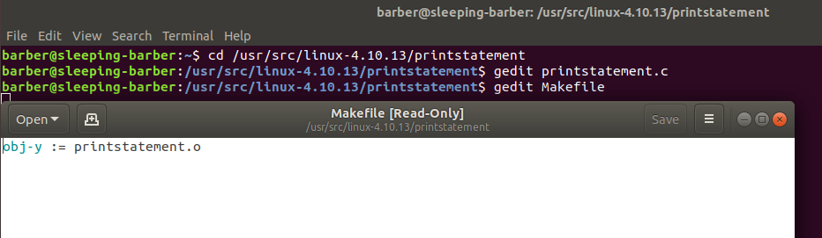

Slide 6
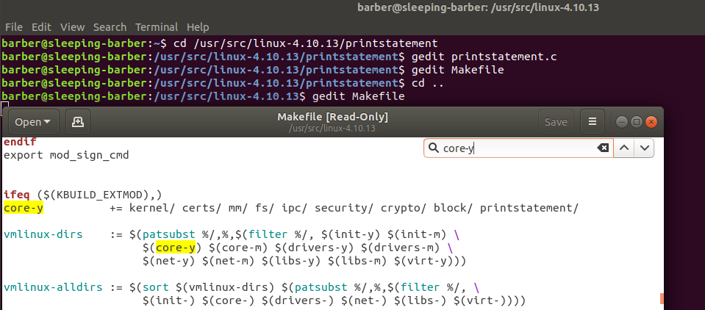

Slide 7
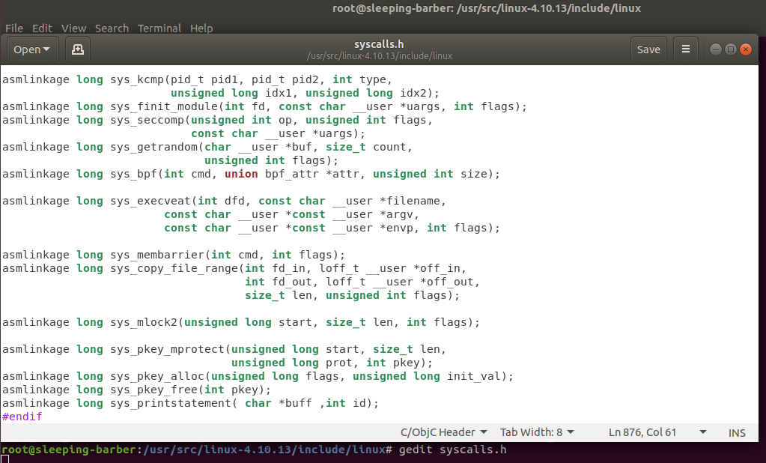

Slide 8
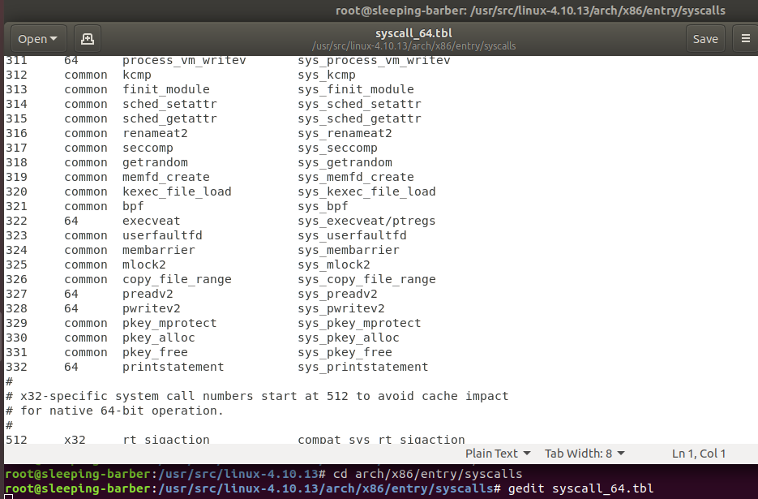

Slide 9
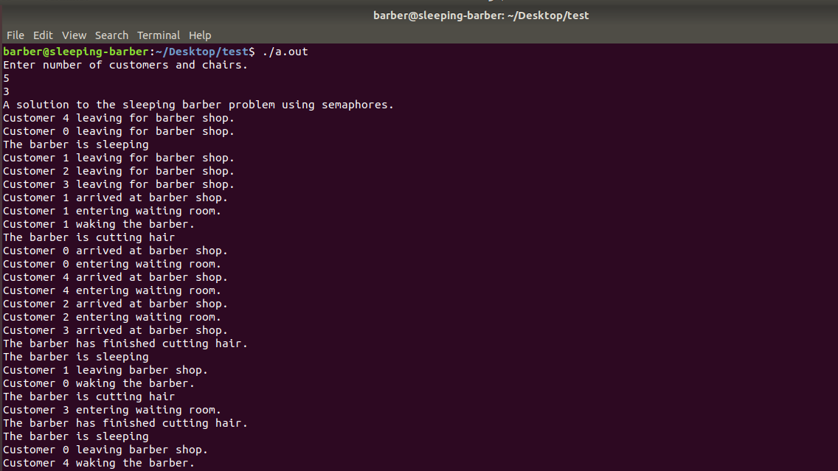
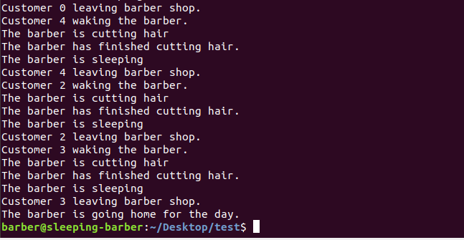
Terminal output

Slide 10
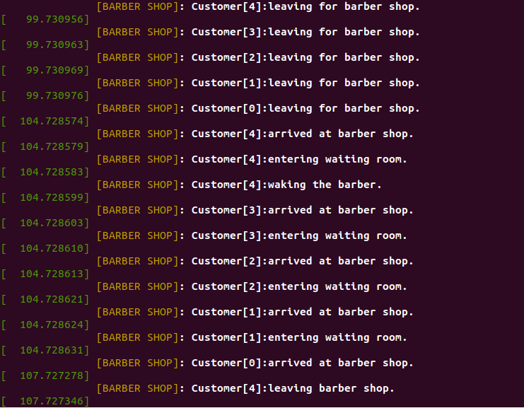
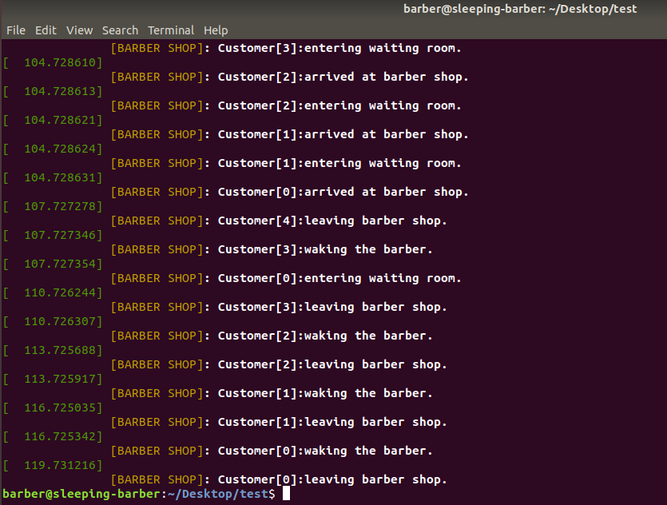
Kernel log

Slide 11
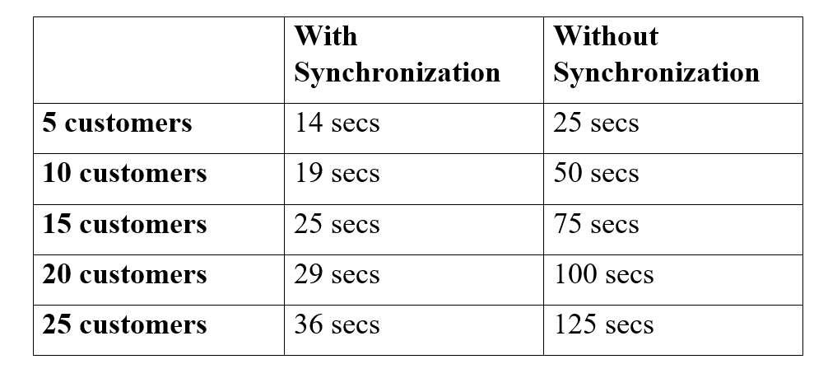
Comparison :

Slide 12
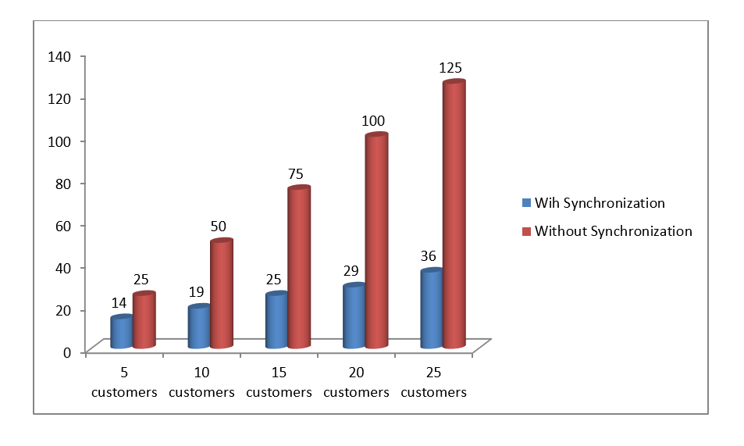
Result:

Slide 13
Conclusion:
This project prevents the occurrence of race condition in an barber shop while dealing with multiple customers.

